Slide 1


IBM COURSERA CAPSTONE PROJECT
Weather Stations
Vo Thoi Nay
July 2nd, 2024

Slide 2
OUTLINE
Introduction
Methodology
Results
40 features
Dimension Reduction
20 features
Comparison of all models
Discussion and Conclusion
Notes:
Outline of our presentation

Slide 3

EXECUTIVE SUMMARY
This project is a pure data scence project and is inspired from a real-life problem in measuring weather condition in Europe.
We collect data of five weather stations: Paris, London, Brest, Berlin and Marseille. Imagine that the station in Paris is broken. This project tempt to answer the question if we could predict the temperature in Paris based on the data from other stations. And several predicting methods will be addressed and compared to find the most performed.
The outcome of this project show that the temperature in Paris can be accurately predicted using data from other stations.
Notes:
5 stations => 50 parameters in total
Assumption => Use 40 parameters to predicts 10 features, but in this project we try to compare dif models => 1 para: temperature
Hourly time series data in 40 years, which means a huge amount of data

Slide 4
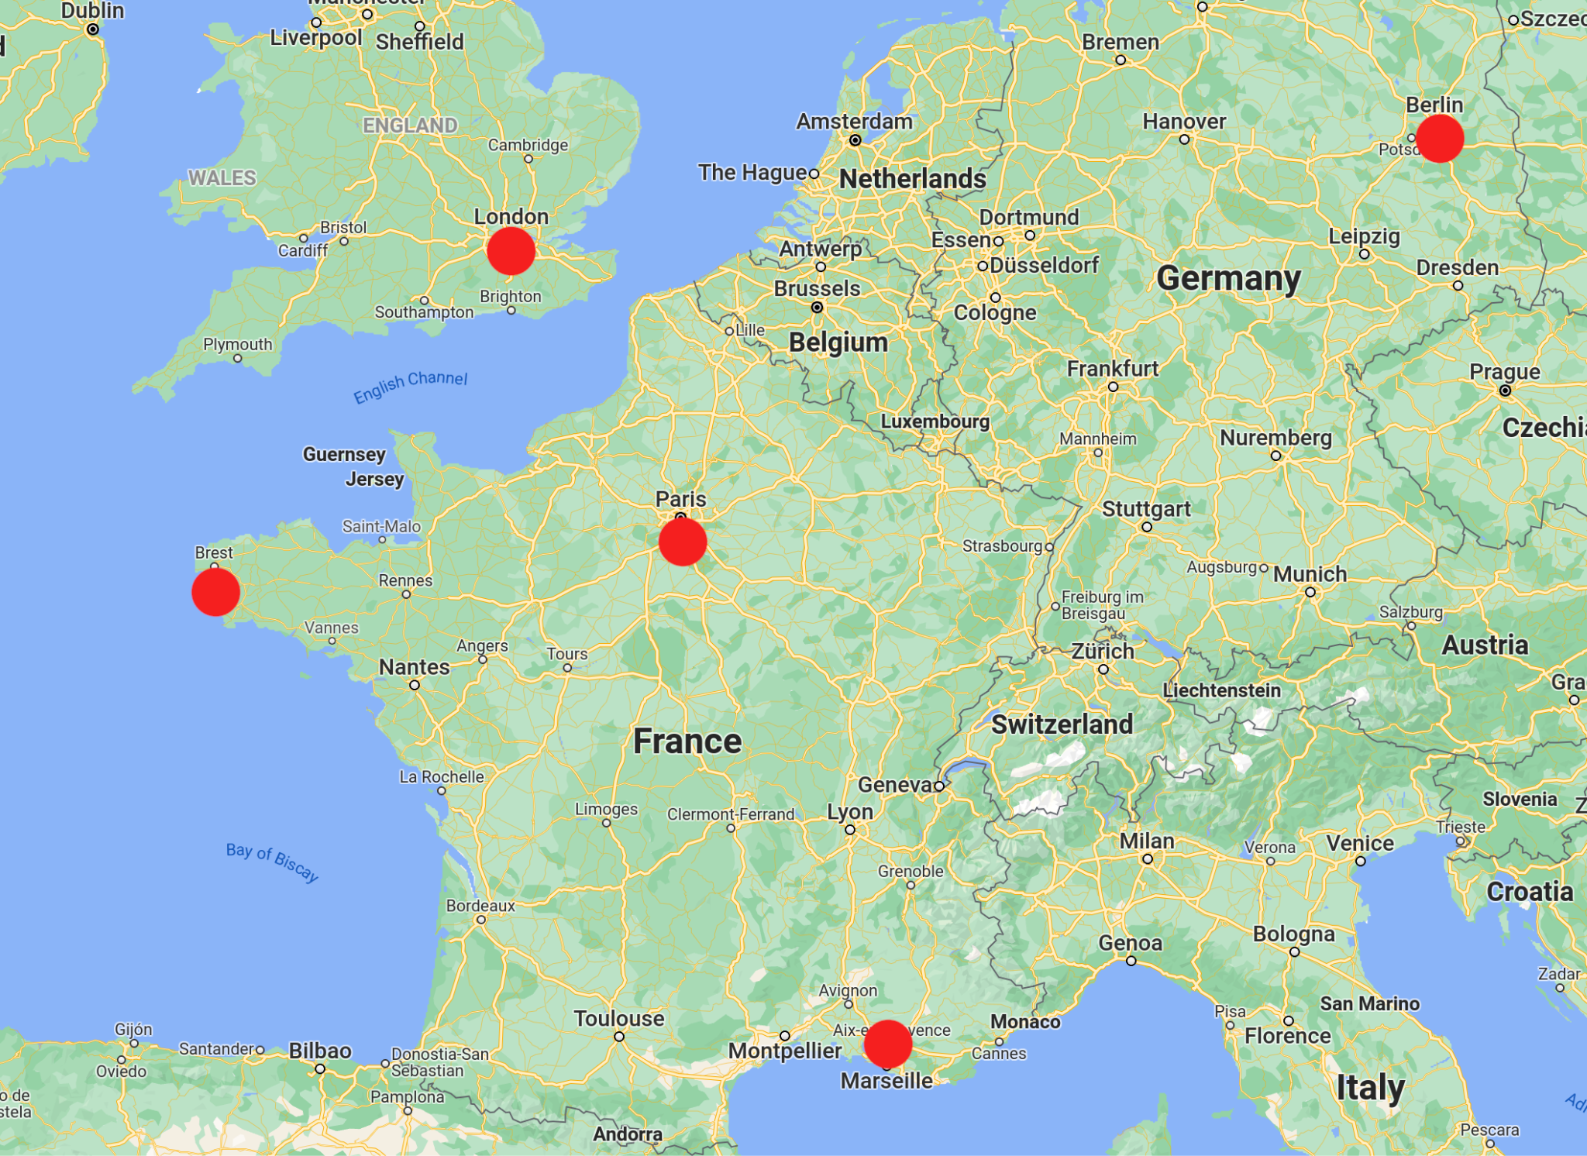
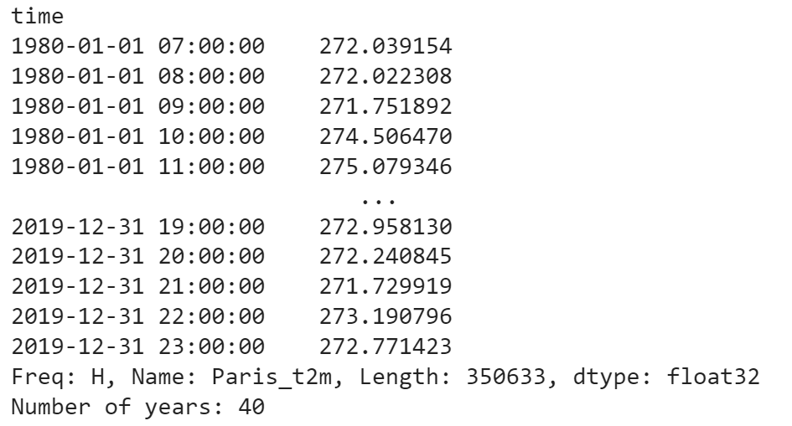
INTRODUCTION
5 stations, 10 different parameters each
Station in Paris is broken => y: Temperature in Paris, X: 40 features
Hourly data, 1980 - 2019
Temperature data in Paris
Notes:
5 stations => 50 parameters in total
Assumption => Use 40 parameters to predicts 10 features, but in this project we try to compare dif models => 1 para: temperature
Hourly time series data in 40 years, which means a huge amount of data

Slide 5
DATA COLLECTION
- Source:
+ The Weather's Record Keeper: https://meteostat.net/en/
+ Personal Weather Station Network: https://www.wunderground.com/pws/overview
- Language used: SQL
- Data Structure:
+ Timeseries data, dated from 1980 to 2019
+ 5 weather stations
+ 10 features each station

Slide 6

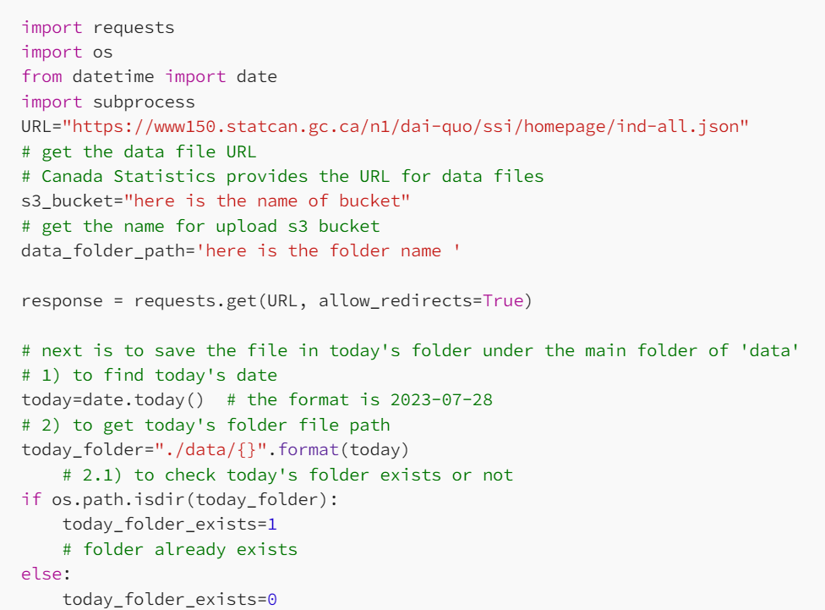

DATA COLLECTION PROCESS

Slide 7
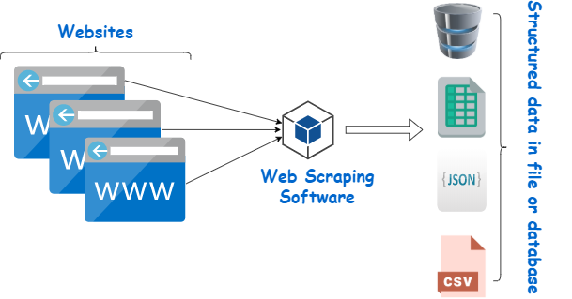
DATA SCRAPING
Data is stored in csv format and structured by SQL language

Slide 8
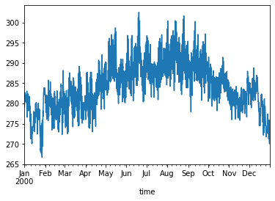
EDA AND DATA VISUALISATION
Time series data collected

Slide 9
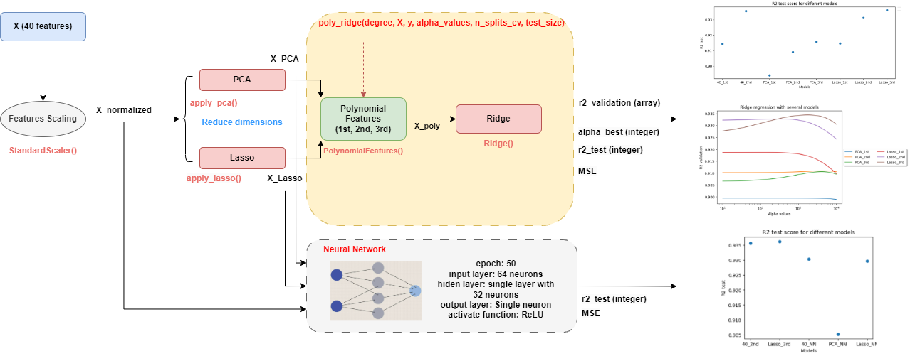
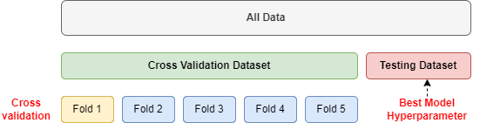
METHODOLOGY
(40 years)
(30 years)
(10 years)
Notes:
Clean the data X and y, Normalize with standard scaler get X_normalized and y_normalized
We transform X normalize into X_poly by Polynomial form either 1st 2nd 3rd degree
Then we apply ridge regularization on X_poly, we split data into two set: cross validation (30 years in 5 folds) to get the best alpha, the use that ridge with that alpha train model on CV to get mse train then to test on the testing set (10 years).
one function called poly_ridge the input of this function is…
The output of this function are…
We can not go up to 3rd degree of 40 features, into 20 features in this case
This family with another one, neural network

Slide 10
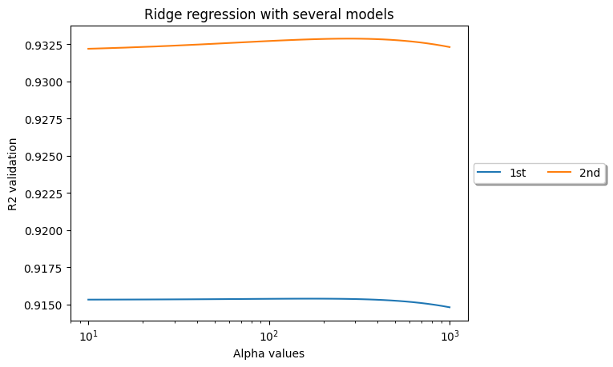
RESULTS - Comparison within 40 features
 | MSE_train | MSE_test
1st | 0.078 | 0.088
2nd | 0.056 | 0.067
Table1. MSE of best alpha for two models
Notes:
Implement our method with 40 features first
The R2 validation over the range of alpha from 10 to 1000
The variation due to degree of polynomial > the one due to the regulation
when we look at the MSE_train and test of two model at the best value of alpha, 2nd one give us a better performance,
Look at the magnitude of MSE the performance is pretty good.

Slide 11
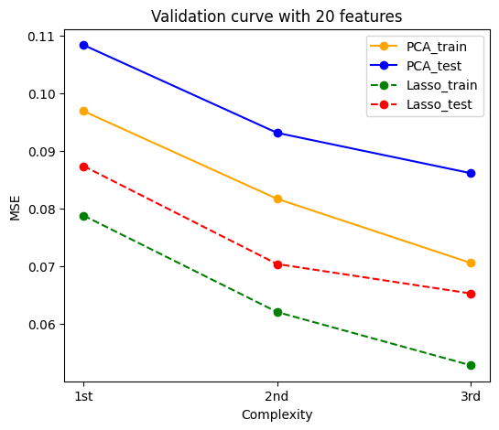
RESULTS - 20 Features Validation Curve (alpha = 0)
Notes:
X_20_lasso X_20_PCA
Plot the validation curve 20 features without ridge regularization with two different method of dimension reduction
Lasso give us the best result in term of MSE
First and second degree here seems to be underfitting.

Slide 12
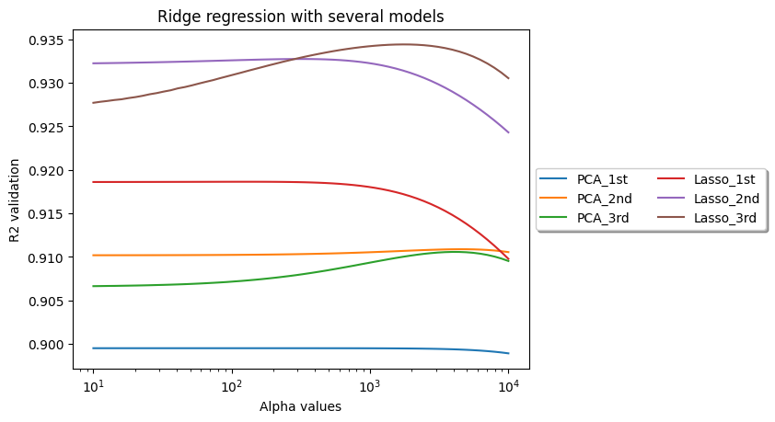
RESULTS - Comparison within 20 features
Notes:
From the graph, we can observe several trends:
As the alpha value increases, the performance of the first-degree polynomial features declines slowly, which suggests that these models are less sensitive to the increase in regularization.
The second and third-degree polynomial models (both PCA and Lasso) tend to have lower R^2 scores at lower alpha values compared to the first-degree polynomial models. This could indicate overfitting when regularization is low.
The Lasso models show a more pronounced decline in performance with increasing alpha values compared to PCA models. This is likely because, as alpha increases, Lasso is reducing the number of features more aggressively, which can lead to underfitting.
This indicates that the Lasso model may be more sensitive to increases in regularization, possibly due to a higher initial number of features that are being penalized and reduced to zero.

Slide 13
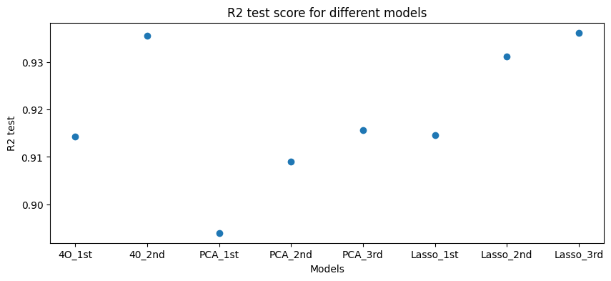
RESULTS - Comparison with different models

Slide 14
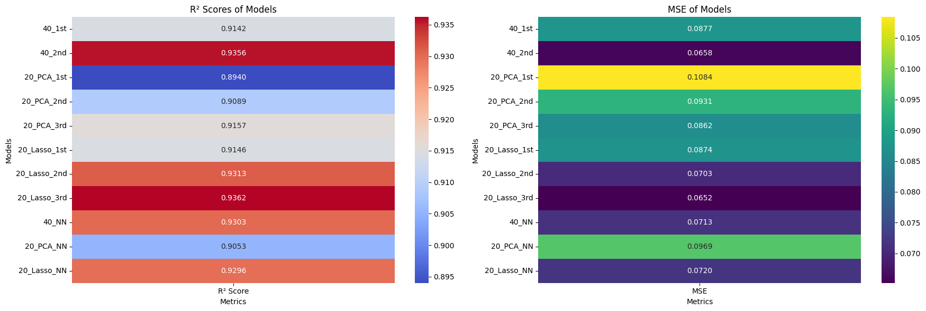
EDA WITH SQL RESULTS

Slide 15
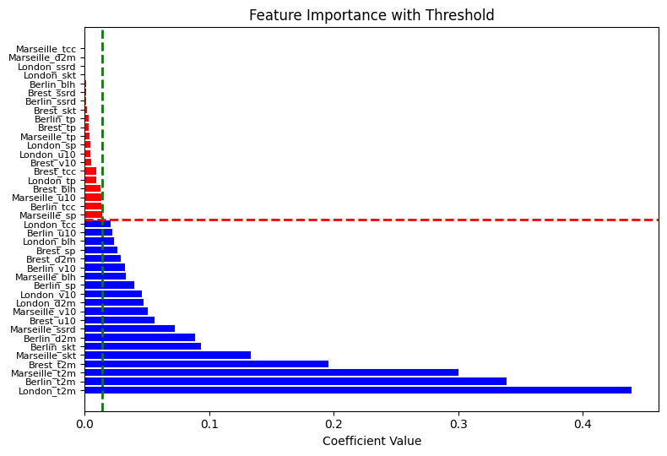
PLOTLY DASH DASHBOARD RESULTS
Notes:
We choose here the number of feature is 20 cause we could go upto 25 or 30 with 3rd degree
Some of the features that are the most important in predicting the temperatures in Paris, I four most important one are the temperature in different stations
20 features is then chosen for PCA as well

Slide 16
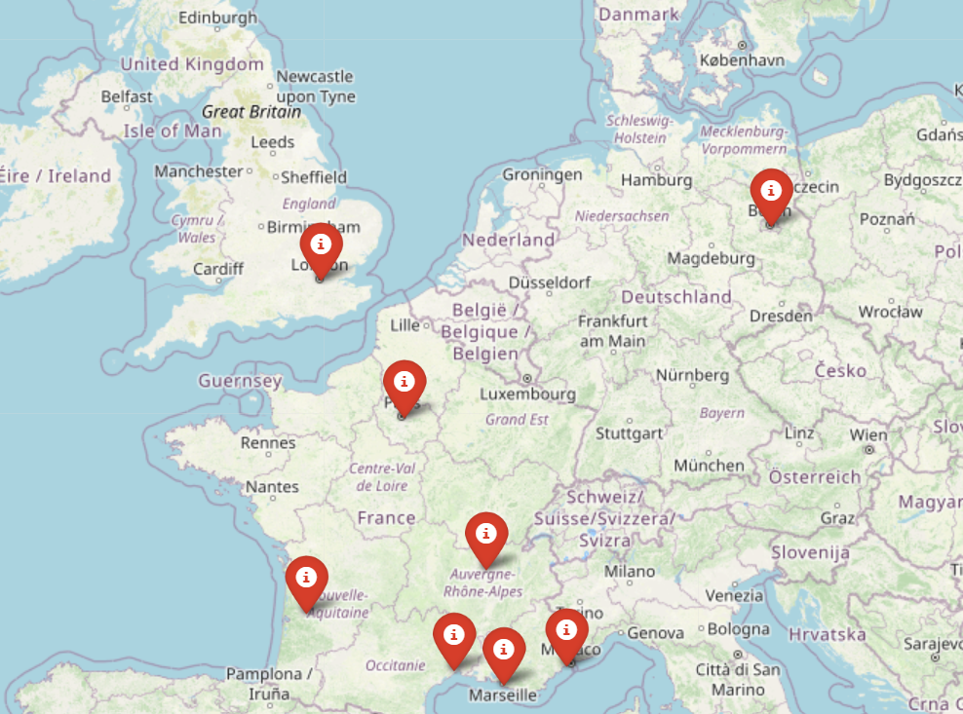
INTERACTIVE MAP WITH FOLIUM
file:///C:/Users/Nay/Downloads/interactive_map_europe.html
Notes:
file:///C:/Users/Nay/Downloads/interactive_map_europe.html

Slide 17
DISCUSSION & CONCLUSION
Data Splitting Methodology: Validation set for parameter tuning, testing set for performance evaluation; nested cross-validation considered but not implemented.
Feature Reduction Insights: Lasso's supervised feature reduction outperformed PCA's unsupervised approach, allowing for the precise selection of the top 20 features from 40, enhancing model effectiveness.
Best Evaluation with 40 features: 2nd-degree polynomial model with alpha best = 268 and R2 test = 0.935.
Best Evaluation with 20 features: 3rd-degree polynomial model reduced by Lasso with alpha best = 1727 and R2 test = 0.936.
Regularization Effects: Lasso's regularization had a more substantial impact on performance alteration than PCA.
Neural Network Comparison: Compared with the best models (40_2nd degree, Lasso_20_3rd degree) from polynomial families, neural networks perform worse.
The temperature in Paris can be accurately predicted using data from other stations.
Notes:
Number of Features: so basically here we also need to discover more about number of features. In our case, we arbitrarily choose the features with lasso. But if we choose randomly 20 features, we dont know which will be better. And another thing is that in the case of the comparison between direct polynomial regression with polynomial regressions, due to the limited of memory, we know that the direct polynomial regression with 3rd degree will have a better performance.

Slide 18
APPENDIX - Parameters
Abbreviation | Description
skt | Skin Temperature - The temperature of the land or sea surface.
u10 | 10-meter U Wind Component - The east-west (zonal) component of wind speed measured at 10 meters above the ground.
v10 | 10-meter V Wind Component - The north-south (meridional) component of wind speed measured at 10 meters above the ground.
t2m | 2-meter Temperature - The air temperature measured at 2 meters above the ground.
d2m | 2-meter Dewpoint Temperature - The dewpoint temperature measured at 2 meters above the ground, which indicates moisture.
tcc | Total Cloud Cover - The fraction of the sky covered by clouds.
sp | Surface Pressure - The atmospheric pressure at the earth's surface.
tp | Total Precipitation - The accumulated precipitation (rain, snow, etc.) over a specified period.
ssrd | Surface Solar Radiation Downwards - The amount of solar radiation reaching the ground.
blh | Boundary Layer Height - The height of the lowest part of the atmosphere where the earth's surface significantly influences temperature, moisture, and wind.

Slide 19
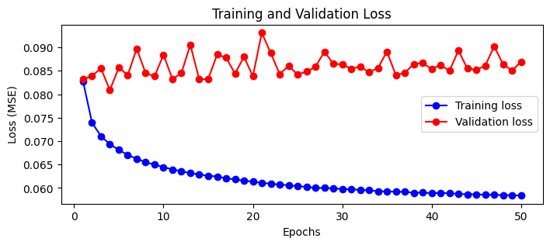
APPENDIX - Learning Curve for Neural Networks
Learning Curve for neural network prediction for 20 features (after PCA)

